Slide 1

Instructions for
Mid Term Test Examination
Department of Conduct-Regular, Division of Examination

Slide 2
Types of mid Term test (mTt)
Students are not allowed to go outside for any reason during the examination.
01
Type 1: Objective
MCQ’s
(Duration: 1.Hrs 30Min)
Type 2: Mix
MCQ and Theory
(Duration: 1Hrs 30Min)
Students are not allowed to go outside for any reason during the first 60 minutes and after half time from the commencement of examination.
However, students can leave the examination room after the submission of answer sheet and question paper on expiry of half time.
02
Type 3: Subjective
Theory questions
(Duration: 1Hrs 30Min)
Students are not allowed to go outside after half time from the commencement of examination.
However, student can leave the examination room after the submission of answer sheet and question paper on expiry of half time.
03
For detailed instruction follow the path -
Important Links ----> Policies, Rules, Instructions, Guidelines & formats---> Examination Instructions and Guidelines ----->Mid Term Test (Theory) Guidelines.

Slide 3
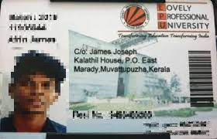
Instructions for Students
Every student must carry valid University identity card to ensure his/ her physical identity during the examination.
Students are not allowed to appear in an examination without University ID card.
In case a student does not carry the University ID Card due to Unforeseen Circumstances.
Student shall be required to download and print the admit card available on the following UMS path and show the same to the invigilator.
UMS Navigation ---> Examination system ---> Admit card

Slide 4
Instructions for Students
Room Opening
Reporting
Avoid possession of any helping material.
Ensure the Correct Answer Sheet/OMR
The examination center will open half an hour before the start of exam.
All students must occupy allocated seats as per reporting time i.e. 30 Minutes before the start time of examination.
Before the start of examination, students shall properly check his/her pockets, allotted seat and floor surrounding his seat for any kind of chits/paper etc.
Before the start of examination Students shall count the number of pages of answer sheet. In case of any misprint report the same to invigilator.
While receiving the OMR sheet each student must verify his/her credentials as printed on OMR.
01
02
03
04
For detailed instruction follow the path -
Important Links ----> Policies, Rules, Instructions, Guidelines & formats---> Examination Instructions and Guidelines -----> Mid Term Test(Theory) Guidelines.

Slide 5
Instructions for Students
Students must ensure that they have the question paper of correct course code.
In case they attempt the question paper of the wrong course code, then their paper will not be evaluated and no chance will be given to him/her.
In case of MCQs based examination, students must ensure that the question paper has same “set code” as mentioned on OMR sheets.
DISCREPANCY IN QUESTION PAPER:- Discrepancies in the question paper must be reported in writing to the superintendent of center immediately after the examination is over or the same must be reported to the Division of Examination within 24 hrs through RMS as per following path :-
UMS Navigation --- >Relationship Management System (RMS) --- >Log Request ---> Select:- Message Type: - Grievance Search by Category:-Examination Master Category: - Examination Category: - Examination Sub Category: - Seating plan theory/ETP exam
02
For detailed instruction follow the path -
Important Links ----> Policies, Rules, Instructions, Guidelines & formats---> Examination Instructions and Guidelines ----->Mid Term Test (Theory) Guidelines.

Slide 6
Attendance During Examination
01
Students must mark his/her attendance on the attendance sheet and write all the details such as OMR sheet no., Answer booklet number along with their signature in designated columns.
02
If student does not mark his/her attendance on the attendance sheet, he/she will be considered as absent.
For detailed instruction follow the path -
Important Links ----> Policies, Rules, Instructions, Guidelines & formats---> Examination Instructions and Guidelines ----->Mid Term Test (Theory) Guidelines.

Slide 7
Instructions for Students
CCTV Surveillance
01
During examination, each student is are under CCTV surveillance.
02
A dedicated team of Examination official continuously monitoring student movement through CCTV. Any Unfair activity observed through the CCTVs, leads to immediate action and Unfair mean case against the student.
For detailed instruction follow the path -
Important Links ----> Policies, Rules, Instructions, Guidelines & formats---> Examination Instructions and Guidelines ----->Mid Term Test (Theory) Guidelines.

Slide 8
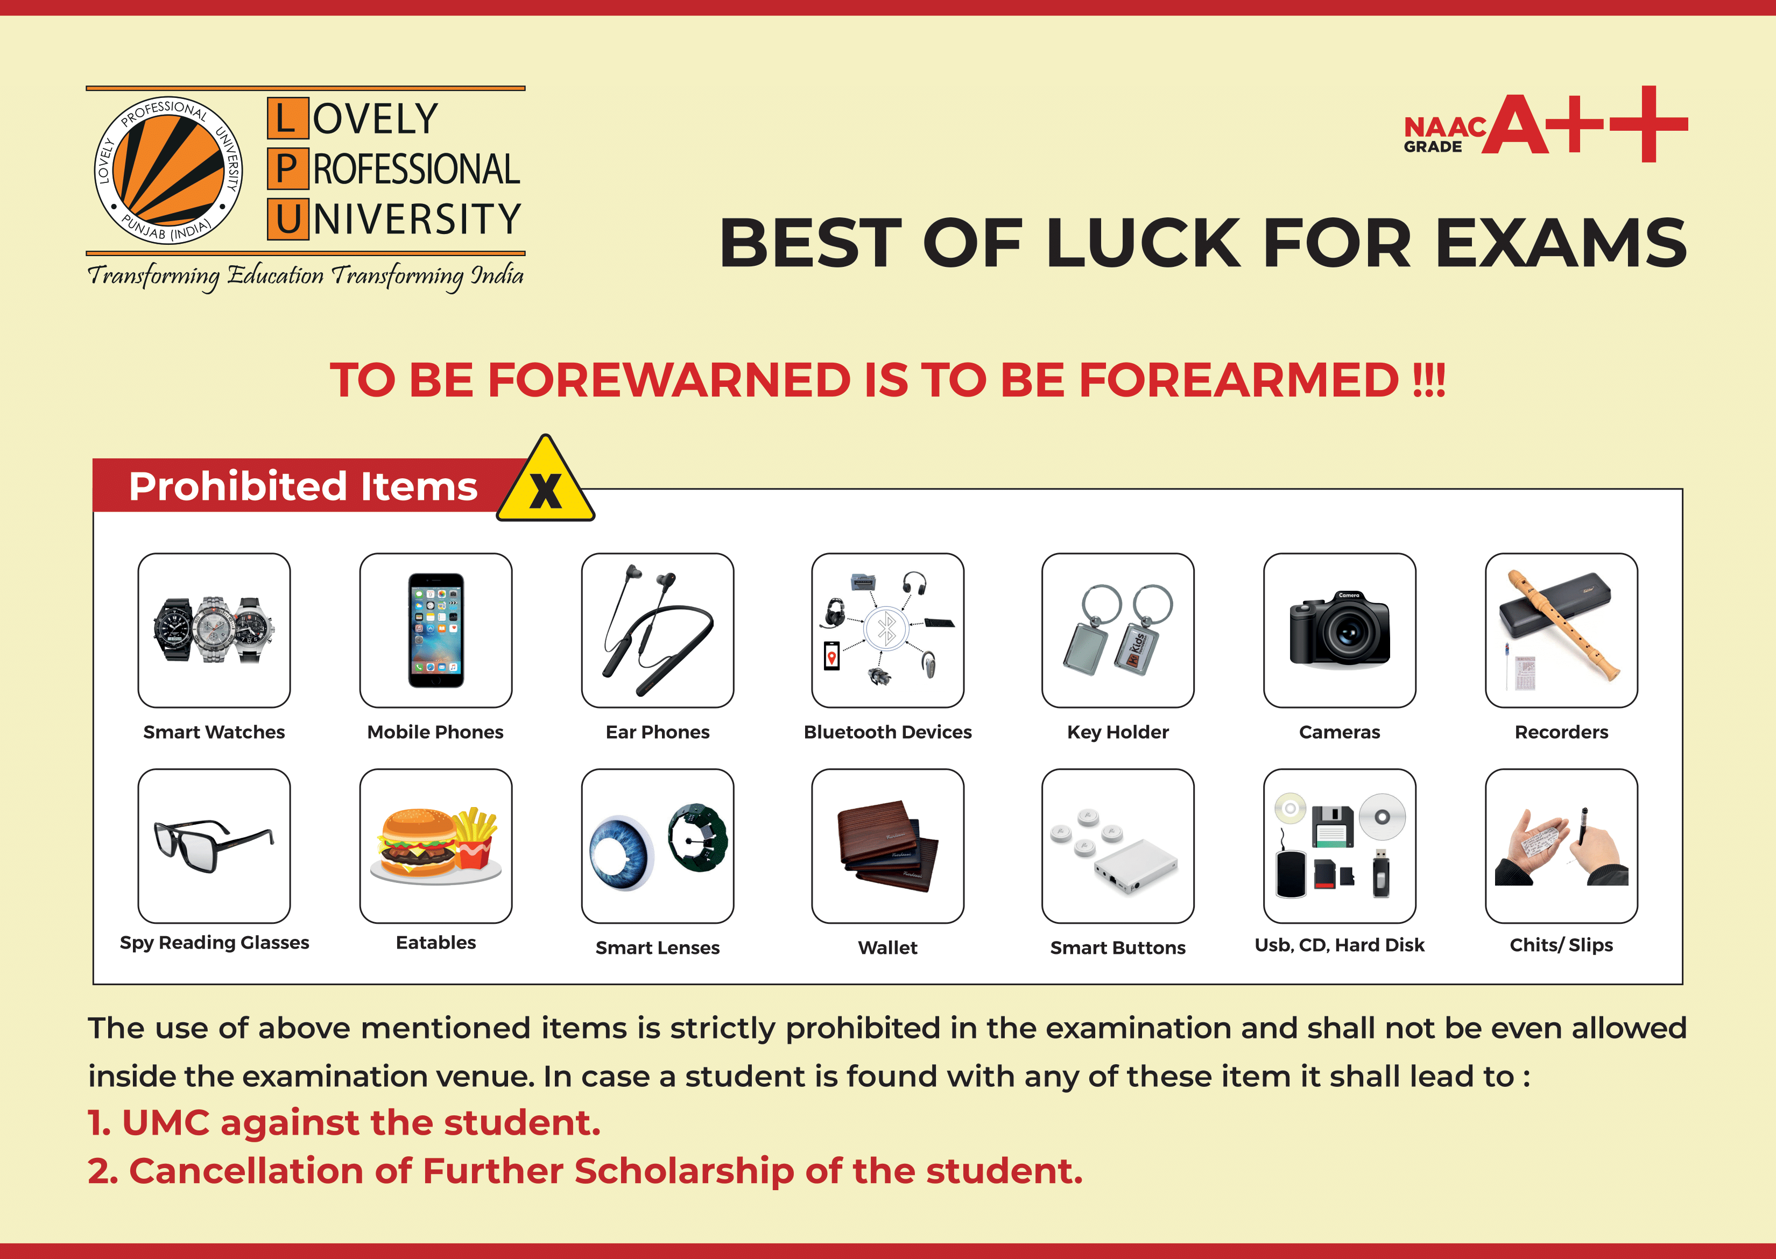

Slide 9
01
The possession of any bag, electronic devices and printed material in an examination center is strictly prohibited. If student carry such things in examination center he/she will not allow to enter the examination room. In such scenario no extra time will be provided to the student.
02
Students are not allowed to copy and discuss anything with his/her fellow students during the examination.
03
No Argument in the examination centre will be entertained during processing of Unfair Means Case.
04
If any candidate found with the prohibited item during the examination, he/she will face Unfair means case (UMC).
05
Students are not allowed to write/mark anything on the question paper except registration number on the designated space. Even a small mark or dot on the question paper will be considered as UMC.
For detailed instruction follow the path -
Important Links ----> Policies, Rules, Instructions, Guidelines & formats---> Examination Instructions and Guidelines ----->Mid Term Test (Theory) Guidelines.

Slide 10
Unfair Means Case
If any student found with any piece of paper, printed material/notes or any electronic device his/her answer sheet will be cancelled and UMC case will be framed as per the prescribed examination rules.
Further, all students are hereby informed that if anyone is found involved in any act that amounts to “Unfair Means Case”, then his/her university scholarship shall stand cancelled for rest of the programmer duration along with a penal action as per university regulations.
For detailed instruction follow the path -
Important Links ----> Policies, Rules, Instructions, Guidelines & formats---> Examination Instructions and Guidelines ----->Mid Term Test(Theory) Guidelines.

Slide 11



Communicable Infection
In case a student has a communicable infection which may have serious impact on the health of other students/staff in the examination venue, he/she will not be allowed to appear in the examination.
In such a case a free of cost chance shall be given to student in the upcoming re-appear/backlog examination upon submission of a valid medical certificate for the same in 32-101A (Examination Window).
For detailed instruction follow the path -
Important Links ----> Policies, Rules, Instructions, Guidelines & formats---> Examination Instructions and Guidelines ----->Mid Term Test (Theory) Guidelines.
Notes:
https://unsplash.com/

Slide 12
Mid Term Test (Theory) Guidelines.
Students can check the Details instruction/guidelines step-by-step for the offline examination through following path.
Important Links ----> Policies, Rules, Instructions, Guidelines & formats---> Examination Instructions and Guidelines -----> Mid Term Test (Theory) Guidelines.

